Slide 1
Generators
Dr. Adeel Ansari

Slide 2
Topics to be covered
Yeoman Generators for Scaffolding Web Apps

Slide 3
What is a generator
Generators have become quite famous in Node.js in recent times and that probably because of what they are capable of doing.
Generators are function executions that can be suspended and resumed at a later point.
Generators are useful when carrying out concepts such as 'lazy execution'. This basically means that by suspending execution and resuming at will, we are able to pull values only when we need to.
Generators are used to solve the problem of what is known as callback hell. Sometimes callback functions become so nested during the development of a Node.js application that it just becomes too complicated to use callback functions.
Generators are the building blocks of the Yeoman ecosystem. They’re the plugins run by yo to generate files for end users

Slide 4
What's Yeoman?
A lot of generators rely on build systems (like Grunt or Gulp), and package managers (like npm and Bower).
Yeoman helps you to kickstart new projects, prescribing best practices and tools to help you stay productive.
To do so, we provide a generator ecosystem. A generator is basically a plugin that can be run with the yo command to scaffold complete projects or useful parts.
# install yo
npm install --global yo
# install a generator
npm install --global generator-webapp
# run it
yo webapp
gulp serve
First thing is to install yo using npm:
Then install the needed generator(s). Generators are npm packages named generator-XYZ.
Search for them on our website or by selecting “install a generator” menu option while running yo. To install the webapp generator:
To scaffold a new project, run:

Slide 5


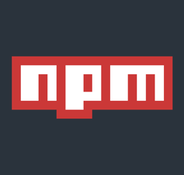
What's Yeoman?
The Yeoman workflow comprises three types of tools for improving your productivity and satisfaction when building a web app: the scaffolding tool (yo), the build tool (Gulp, Grunt etc) and the package manager (like npm and Bower).
yo scaffolds out a new application, writing your build configuration (e.g Gulpfile) and pulling in relevant build tasks and package manager dependencies (e.g npm) that you might need for your build.
The Build System is used to build, preview and test your project. Gulp and Grunt are two popular options.
The Package Manager is used for dependency management, so that you no longer have to manually download and manage your scripts. npm and Bower are two popular options.

Slide 6
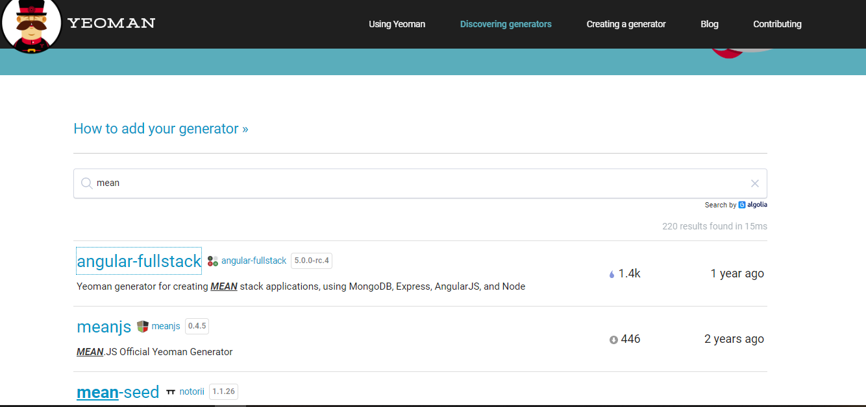
Yeoman Site for detailed instructions
Visit: https://yeoman.io/
To see the list of generators, visit: https://yeoman.io/generators/

Slide 7
Reference
https://www.tutorialspoint.com/mongodb/index.htm
https://codeburst.io/writing-a-crud-app-with-node-js-and-mongodb-e0827cbbdafb
https://medium.com/@bhanushali.mahesh3/creating-a-simple-website-with-node-js-express-and-ejs-view-engine-856382a4578f
https://www.codementor.io/@mayowa.a/how-to-build-a-simple-session-based-authentication-system-with-nodejs-from-scratch-6vn67mcy3

